Slide 1

Introduction to Workforce Planning

Slide 2
What is Workforce Planning?
“Aims to ensure organisations strategically plan to have sufficient staff (clinical and non-clinical), with the appropriate skills, to meet the current and future needs of their population.”
(www.healthcareworkforce.nhs.uk)

Slide 3
Who needs to be involved?
Internally
Within own directorate / division
Across directorate/ division who may be affected by workforce change
With colleagues in supporting corporate directorates e.g. Finance, HR
Externally
Commissioners
Public / Patients
Other NHS Trusts
Local authorities
Voluntary / Independent sector
Regulatory bodies

Slide 4
Why do you need to consider Workforce?
Changes to the NHS in terms of care settings, demographics and delivery methods require significantly different skills, capabilities and approaches to working.
Workforce implications need to be accounted for at every stage of the commissioning cycle. Without due consideration, Commissioners risk perpetuating workforce issues or requesting specifications that cannot be delivered, because the skills and people do not exist in the system.
70-80% of the workforce will still be there in 5 years, but required to work in significantly different settings, the impetus to lead, measure and support workforce development discussions is even greater.
Ensuring a sufficiently skilled workforce is a shared issue, requiring system wide collaborative action in 1-5 year planning.
Challenging Financial climate we are in requires us to plan differently to how we have in the past

Slide 5
A good plan ……
Mitigates staffing crises and shortfalls in service
Encourages teamwork often crossing multi-disciplinary boundaries
Make best use of current staff
Articulates and plans for education and training needs
May develop new, more flexible careers
Improves staff engagement and staff satisfaction
Contributes to ensuring patient safety by having the right skills in place to deliver effective care
Provides a robust platform to support any business case
Demonstrates to commissioners that as a provider we have a competent and skilled workforce to deliver high quality services to the local population.
Enables an effective response to government policy and targets

Slide 6
Traditional barriers to effective Workforce Planning
Lack of engagement and ownership
Short term rather than long term focus – lack of focus
Top down approach
Focus on the numbers
Workforce planning happening in isolation from finance and service planning
Starting point is often “what do we have now?” – limits innovative thinking
Complex – large range of issues to consider

Slide 7
Questions to consider when reviewing your workforce plan
What is the process for developing your workforce plan?
Have key people been engaged with? Choose a hotspot area and ask a service manger if they engaged in the planning?
Has a review of “ safe” staffing levels taken place? Does the plan support the findings e.g. to increased demand in specific areas ?
Does this include areas where there are recommended staffing ratios e.g. midwifery and impact of changes to activity levels over next 5 years e.g. birth rate increasing or decreasing
Is there triangulation between workforce, finance and activity? Have conversations taken place around this and what was the outcome?
Does the plan align to commissioning intentions, reconfigurations and planned service changes? Is it aligned to other submissions

Slide 8
Has the plan taken account of CIP impact on workforce ?
Are there data ESR data quality issues that need to be addressed ? Particularly with coding
Talent management - is there a succession plan for “ hot spots” e.g. small workforce with specialist skills and high percentage due to retire in next 3 years. What are the risks?
Are you getting the most out of your current workforce in terms of skill mix? E.g. assistant and advanced practitioners
Is there a monitor and review process in place for bank agency, sickness absence, turnover

Slide 9
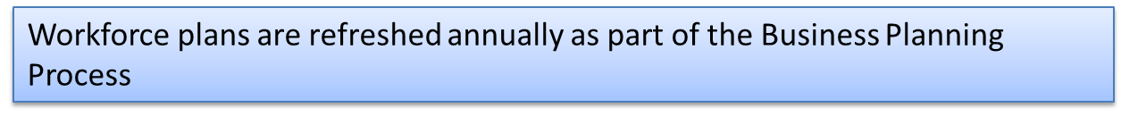
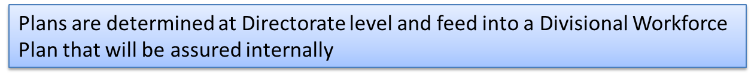
When do you need to do it?
Annually

Slide 10


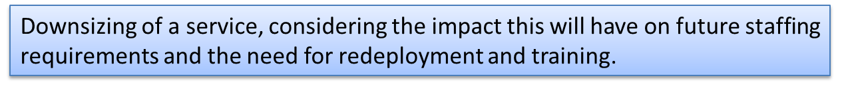
Refreshed throughout the year in light of ….

Slide 11
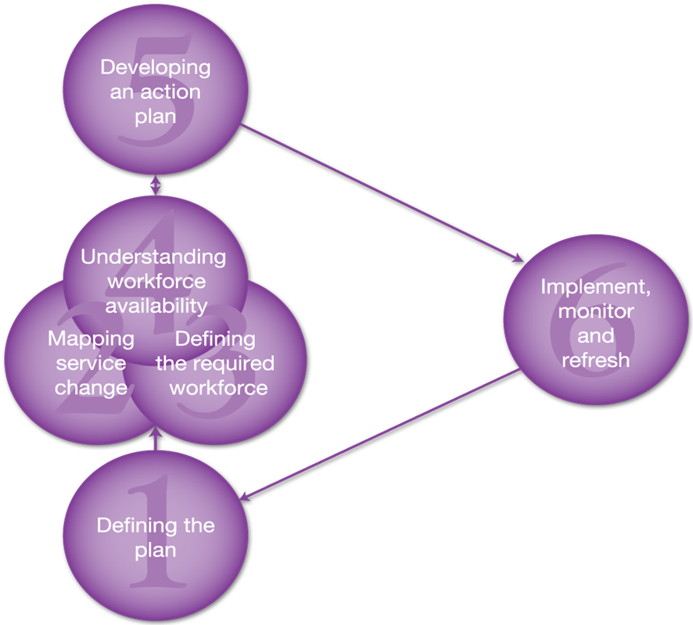
Six Steps to
Workforce
Planning

Slide 12
Step 1: Defining the Plan
Why do you need the workforce plan and who is it intended for?
What is the problem you are trying to solve?
Who needs to be involved in developing the plan?
What are the aims and objectives for the plan?
What is the scope of the plan, i.e. what it covers?
What is the timescale for the plan?
Are there any other decisions that will affect or be affected by the plan?

Slide 13
Step 2: Visioning the Future
Is there a clear vision for the future delivery of the plan or service?
What are the benefits of the plan or service change?
What options are there for the delivery of this plan or service?
Are there any changes or events that may impact on the delivery of the plan or service?
Do you have any control over these changes?
Have you considered the impact a successful or unsuccessful outcome of the plan may have?

Slide 14
Step 3: Defining the required Workforce
What are the key tasks within this service?
What skills and competences will you need in your workforce to deliver these tasks?

Slide 15
Step 4: Understanding Workforce availability
What staff do you have available now?
What is the rate of staff starting and leaving your service?
What are your options to develop/build your workforce?
What are the options for new ways of working?

Slide 16
Step 5: Developing an Action Plan
How well do the current skills, roles and numbers match the expected service need?
What key changes are needed to the current workforce?
Have you drawn up an action plan of your best options (this includes education and other strategies)?
How are you going to manage the change e.g. timescales, responsibilities, champions?

Slide 17
Step 6: Implement, Monitor and Refresh
What needs to happen to ensure the plan is implemented?
How will you measure your progress against the plan’s goals e.g. those agreed in step 1 and 2?
What contingency plans or actions may be needed if the plan does not stay on course or goals are not being met?
Who, how and when will the plan be reviewed?

